Slide 1
Measurement-Augmented Spectrum Databases for White Space Spectrum
Ayon Chakraborty and Samir R. Das
Stony Brook University
WINGS Lab

Slide 2
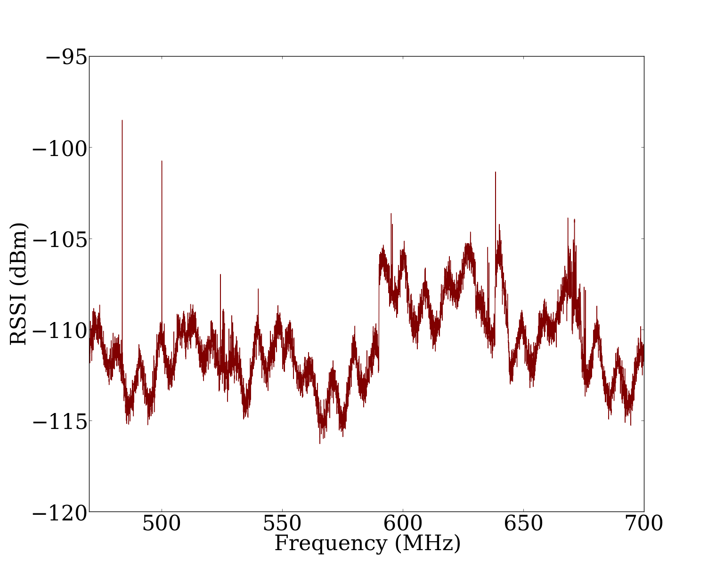
TV White Space Primer
White Space
RSS Threshold
6MHz channels
FCC opened up this spectrum band for unlicensed use in 2008.
Snapshot of the TV Spectrum in Stony Brook, New York.
WINGS Lab

Slide 3
TVWS Availability as a Service
Location: (X,Y)
Secondary
User
TVWS
Database
Estimated WS channels: [23, 34, 41]
Some official TVWS database vendors in the United States:
WINGS Lab

Slide 4
Current Databases are Erroneous
Location: (X,Y)
Secondary
User
TVWS
Database
Estimated WS channels: [23, 34, 41]
Revealed by spectrum sensing at (X,Y)
Ground Truth WS channels: [34, 41, 29, 43]
False Positives
False Negatives
WINGS Lab

Slide 5
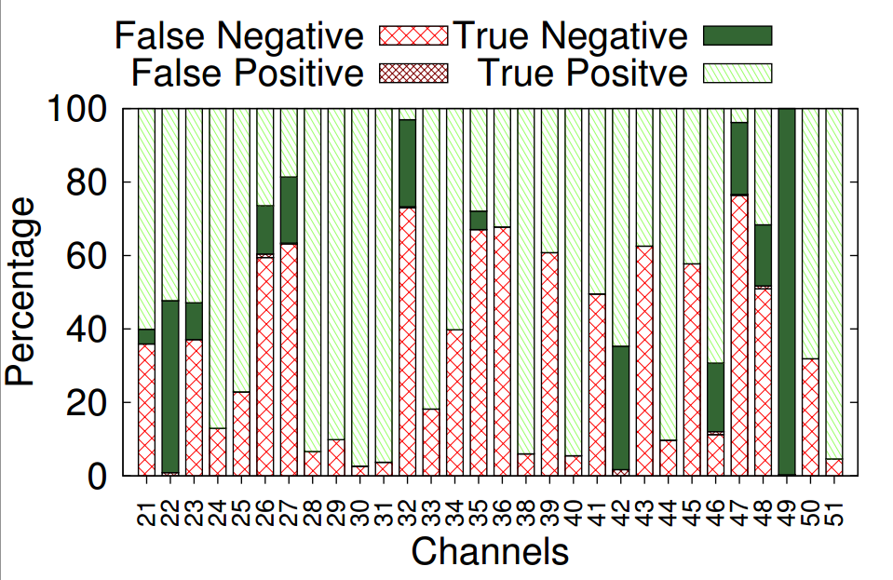
≈75% of Available WS is Lost!
WINGS Lab

Slide 6
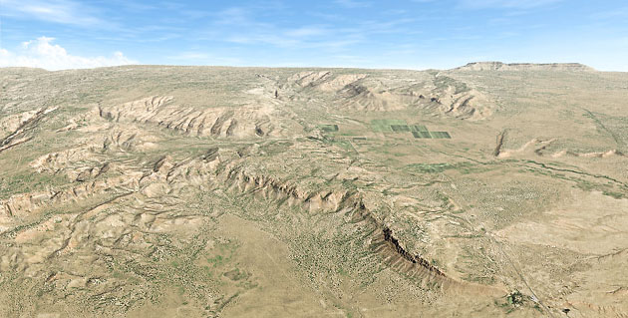
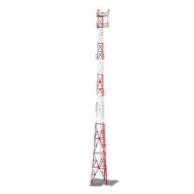
Cause: Poor propagation models
Real Protection Contour
(or service area)
Secondary User
Lost white spaces translates to wasted bit capacity
Estimated Protection Contour
(by TVWS Databases)
WINGS Lab

Slide 7
Fixing Errors – Intuition
Identify regions where database is prone to make more errors.
Use DB propagation model estimates
Do actual measurements
Interpolate rest of the locations
WINGS Lab

Slide 8
The Classifier
<geo-spatial features><label>
<geo-spatial features><label>
<geo-spatial features><label>
<geo-spatial features><label>
Training data
<geo-spatial features><label>
Classifier Model
<geo-spatial features>
True +ve/-ve
False +ve/-ve
A Decision Tree Classifier works best for our system.
Use TVWS DB
Use Measurement
WINGS Lab

Slide 9
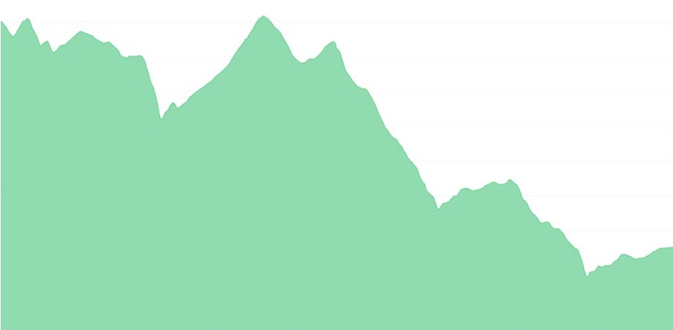
Geo-spatial Features
1. Line-of-Sight Obstruction Length
(NASA SRTM Terrain Data)
Transmitter location
Receiver location
WINGS Lab

Slide 10
Geo-spatial Features
2. Estimated Power
(From TVWS DB using propagation models)
Transmitter location
Receiver location
WINGS Lab

Slide 11
Geo-spatial Features
Transmitter location
Receiver location
3. Distance from Transmitter
WINGS Lab

Slide 12
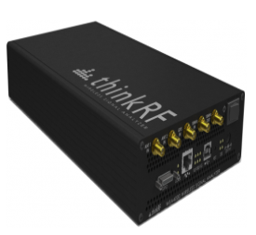
Classifier Label
Location: X,Y
Estimated WS Availability
Ground Truth WS Availability
Obtained from Spectrum Bridge TVWS Database
Measurements using ThinkRF spectrum sensor
Match?
True +ve/-ve
False +ve/-ve
WINGS Lab

Slide 13
Collecting Ground Truth Data
30 DTV channels, 150K+ data points obtained spread across 5K+ locations.
East New Jersey area (approx 250 sq. Km)
Suffolk and Nassau counties, Long Island (approx 150 sq. Km)
WINGS Lab

Slide 14
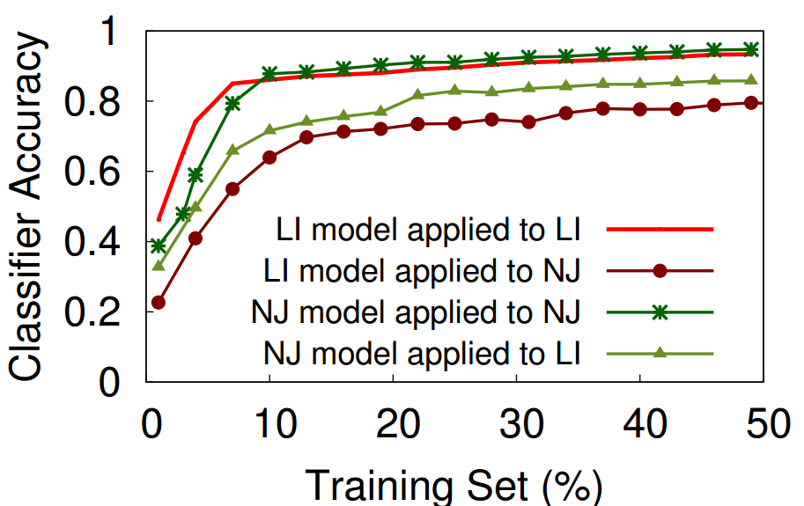
Performance of the Classifier
With ≈10% training data classifier accuracy is ≈80%
The classifier based in a different geographical region performs only incrementally worse than that based in the same region.
WINGS Lab

Slide 15
Effort vs. Accuracy
100%
Exhaustive
Measurement
Opportunistic Measurement
HotNets’13
Mobicom’14
(This work)
Dense Measurement
Prediction Accuracy
Longley-Rice
FCC F-Curve
Model Based
0%
Low
High
Measurement Effort
WINGS Lab

Slide 16
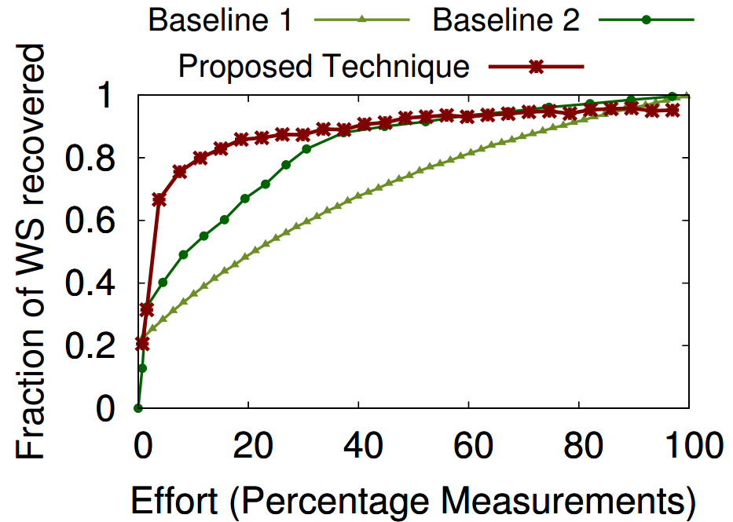
Performance
Measure Random points + interpolate in rest
Measure Random points + TVWS in rest
WINGS Lab

Slide 17
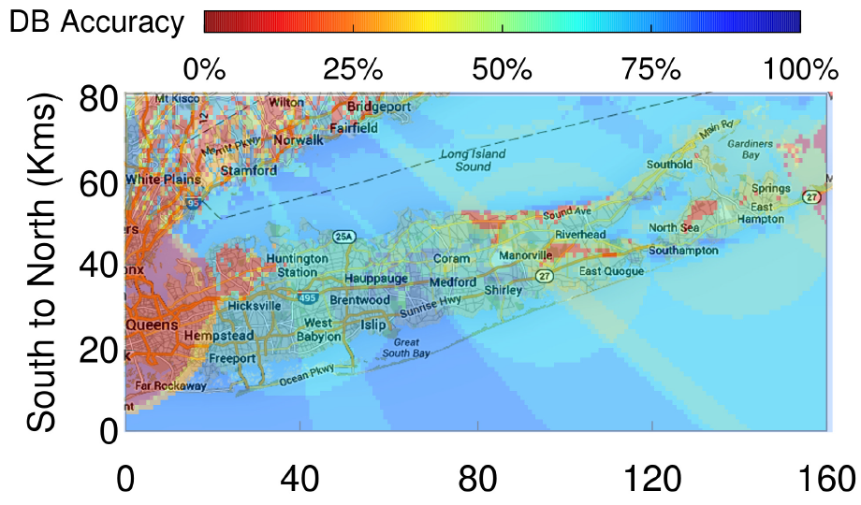
The Big Picture
More patchy
DB grossly erroneous
DB grossly ok
WINGS Lab

Slide 18
Summary
TVWS databases produce erroneous estimates leading to significant loss of usable WS spectrum.
Direct spectrum measurements can remedy this problem but requires significant effort.
We developed a classifier approach that reduces this effort by using measurements only in regions where the databases are likely to be inaccurate.
Overall, significant improvement in accuracy with only modest measurement effort.
WINGS Lab

Slide 19
EOF
WINGS Lab

Slide 20
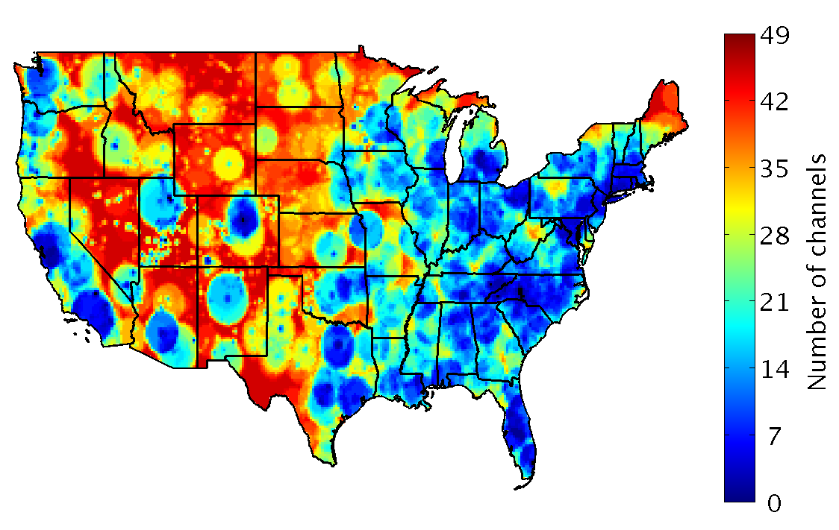
Demand vs. Availability
Chicago (3)
Seattle(4)
New York City (1)
Philadelphia (2)
San Francisco(3)
Houston (3)
Los Angeles (0)
Atlanta (5)
Big population hubs are scarce in white space availability where spectrum demands are the highest.
Map from “How much white space is there?” (Anant Sahai et. al.)
Availability data from Spectrum Bridge
WINGS Lab

